Slide 1

Static vs Instance Variables
Let's discuss the differences now between static variables, and instance variables.
COMPLETE JAVA MASTERCLASS
Static vs Instance Variables

Slide 2
Static Variables
Declared by using the keyword static.
Static variables are also known as static member variables.
Every instance of the class shares the same static variable.
So if changes are made to that variable, all other instances of that class will see the effect of that change.
COMPLETE JAVA MASTERCLASS
Static vs Instance Variables

Slide 3
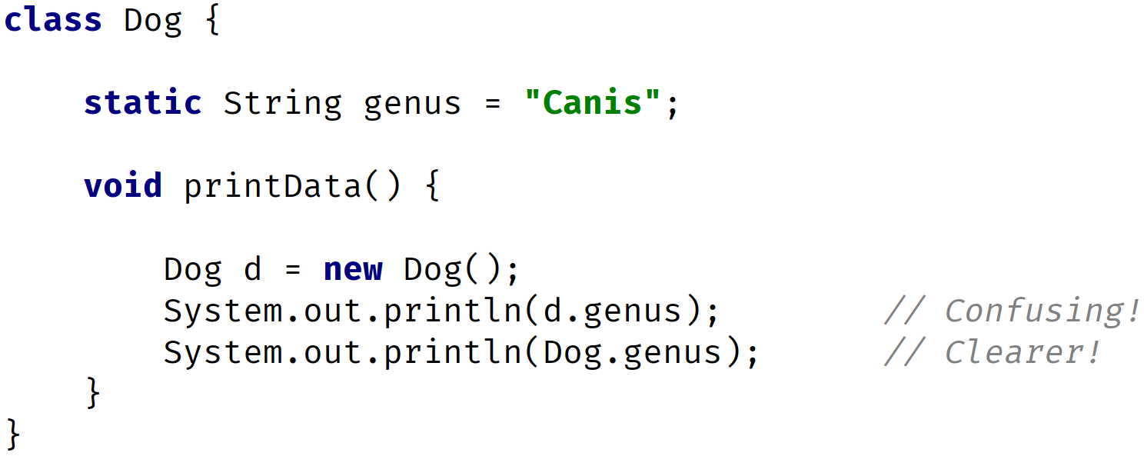
Static Variables
It is considered best practice to use the Class name, and not a reference variable to access a static variable.
COMPLETE JAVA MASTERCLASS
Static vs Instance Variables

Slide 4
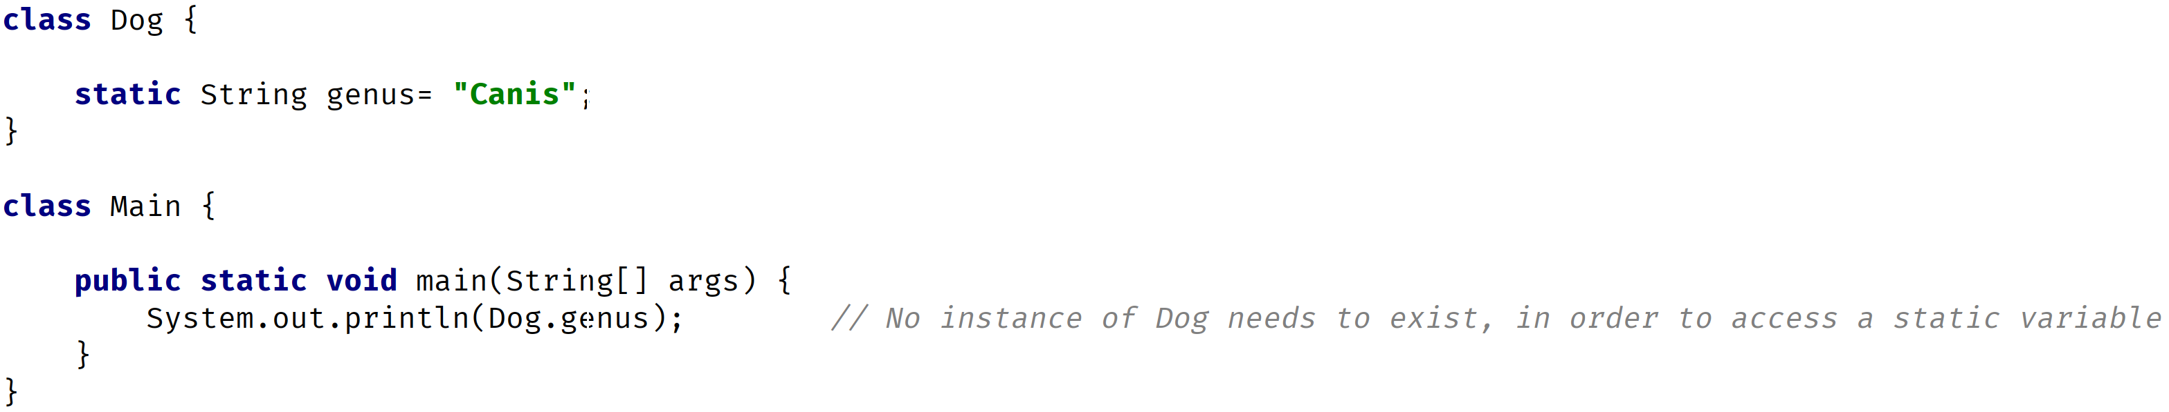
Static Variables
An instance isn't required to exist, to access the value of a static variable.
COMPLETE JAVA MASTERCLASS
Static vs Instance Variables

Slide 5
Static Variables
Static variables aren't used very often, but can sometimes be very useful.
They can be used for
Storing counters.
Generating unique ids.
Storing a constant value that doesn't change, like PI for example.
Creating, and controlling access, to a shared resource.
COMPLETE JAVA MASTERCLASS
Static vs Instance Variables

Slide 6
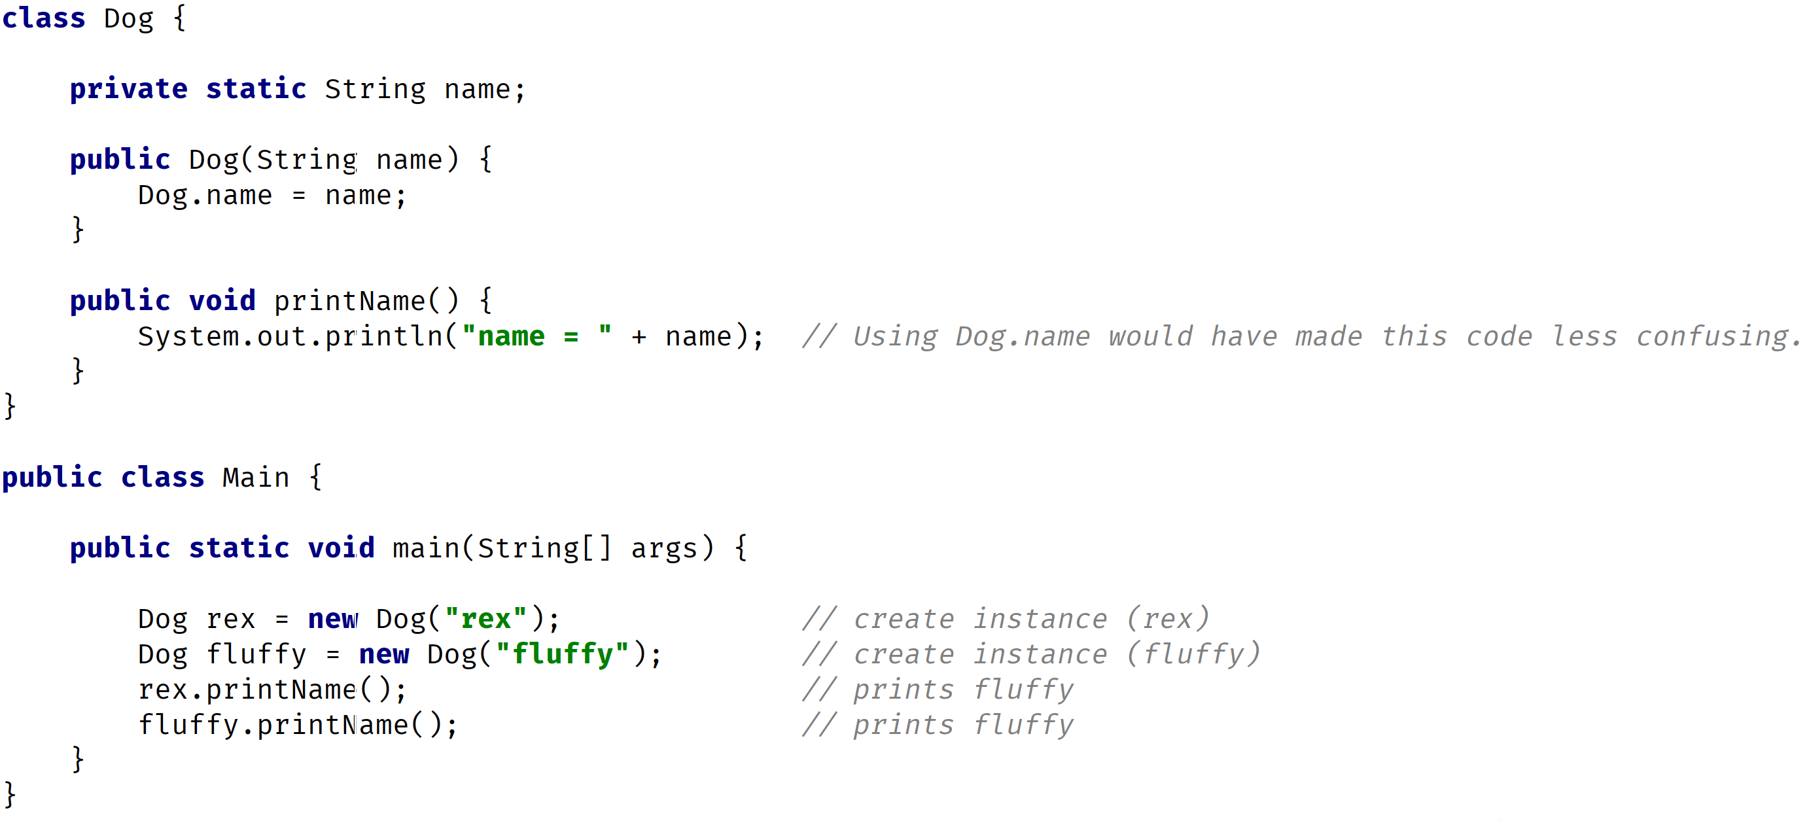
Static Variables
COMPLETE JAVA MASTERCLASS
Static vs Instance Variables

Slide 7
Instance Variables
They don't use the static keyword.
They're also known as fields, or member variables.
Instance variables belong to a specific instance of a class.
COMPLETE JAVA MASTERCLASS
Static vs Instance Variables

Slide 8
Instance Variables
Each instance has its own copy of an instance variable.
Every instance can have a different value.
Instance variables represent the state, of a specific instance of a class.
COMPLETE JAVA MASTERCLASS
Static vs Instance Variables

Slide 9
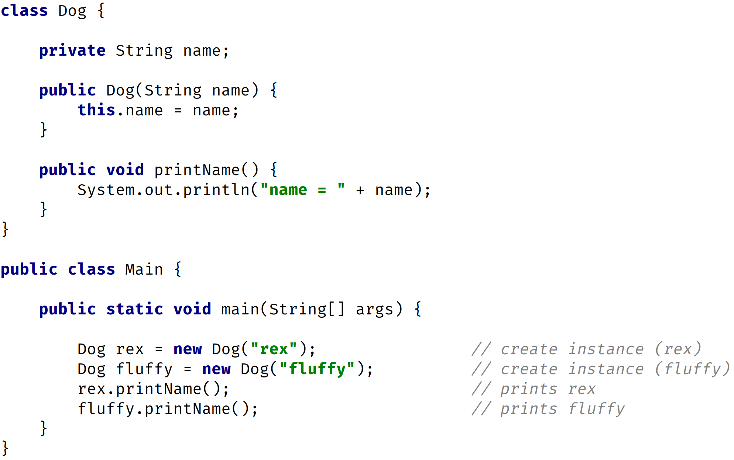
Instance Variables
COMPLETE JAVA MASTERCLASS
Static vs Instance Variables

